Slide 1
Where are the WholEUGrain countries in establishing their own partnerships?
Experience of Federation of Bosnia and Herzegovina
WholEUGrain Spring School Conference, 29th March 2022
Aida Filipović Hadžiomeragić, MD PhD, on behalf of the PHI FBH Project Team
Institute of Public Health of Federation of Bosnia and Herzegovina (PHI FBH)

Slide 2
Prevention of NCDs in Federation of Bosnia and Herzegovina
Government’s commitment to improvement of nutrition and overall health of the population of Federation of Bosnia and Herzegovina confirmed in major health sector policies strategies

Slide 3
Prevention of NCDs in Federation of Bosnia and Herzegovina
Action Plan for Prevention and Control of Chronic Non Communicable diseases of Federation of Bosnia and Herzegovina 2019-2025
Basis for Whole Grain Partnership initiation
Adoption of legislation on reduction of content of salt and trans fats in food products
Improvement of legislation on information for consumer on content and quality of food products
Surveys on dietary intake and habits
Guidelines on healthy nutrition (population, setting)
Campaigns – promotion of healthy nutrition

Slide 4
So far activites
Mapping of stakeholders conducted by the IPH FBH
Stakeholders invited to
Wholegrain Stakeholders event
Event attended by:
public (FSA BH, IPH FBH, MoH FBH)
private stakholders (bakeries Sprind, Klas, ABA)

Slide 5
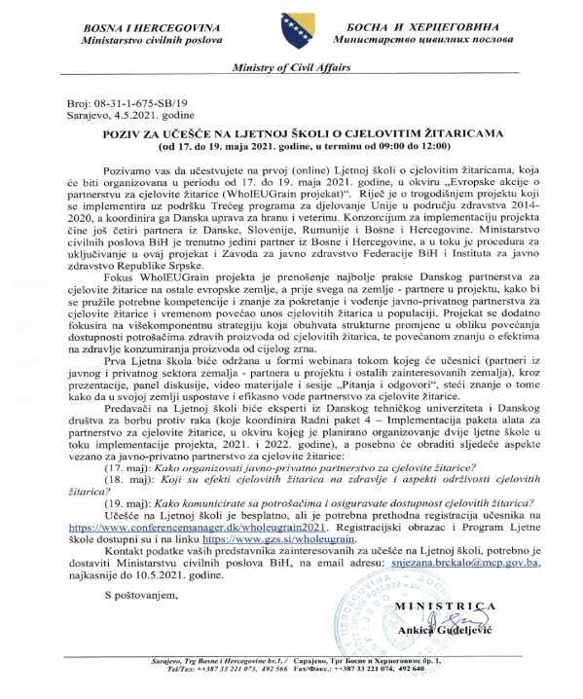
So far activites
Legal documents related to WG production and distribution reviwed
List of stakeholders expanded
Toolbox translated to Bosnian
WholeGrain Summer School attended

Slide 6
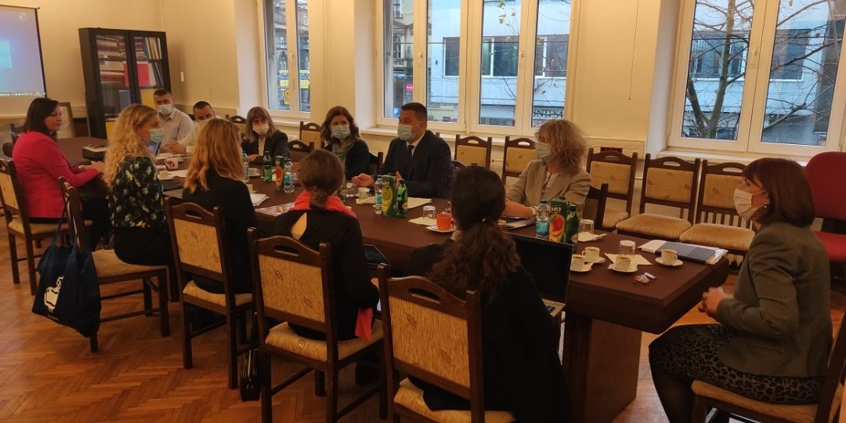
So far activites
Meeting of PHI FBH with wholegrain partners DVA and CCIS – CAFE consultation on the next steps in establishing sub-national partnership

Slide 7
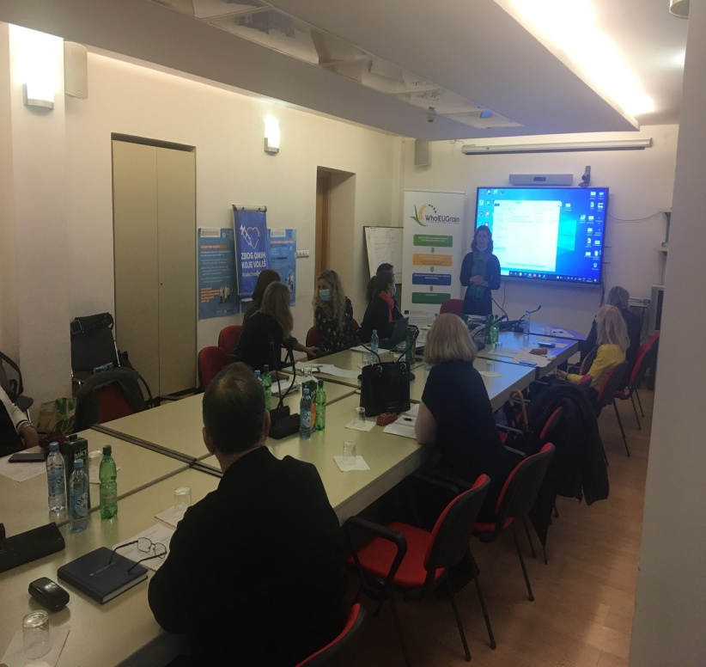
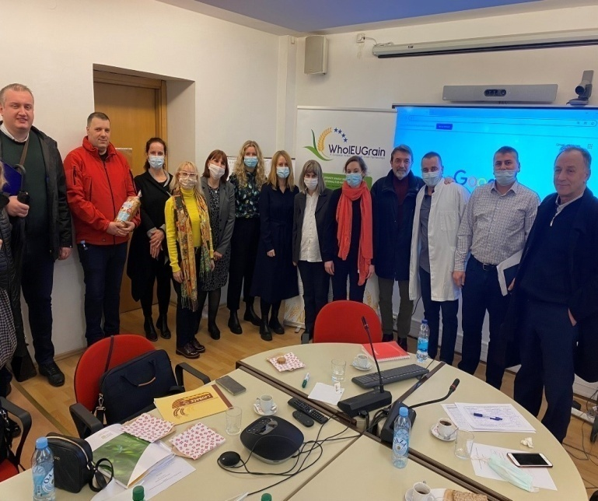
So far activites
First meeting with stakeholders and Wholegrain partners, Decembar 2021
Participants:
Danish Veterinary Agency
Chamber of Commerce of Slovenia
Food Safety Agency of Bosnia and Herzegoina
Chamber of Commerce of F BH
Association of Cardiologists of F BH
Association of Consumers of Canton Sarajevo
Bakery “Ljubača”
PHI FBH team members

Slide 8
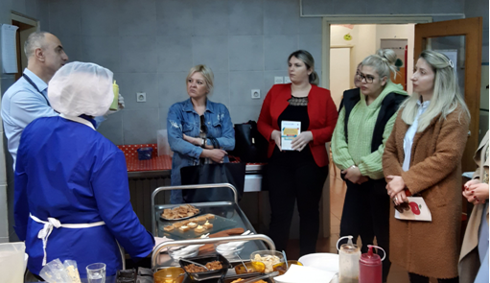
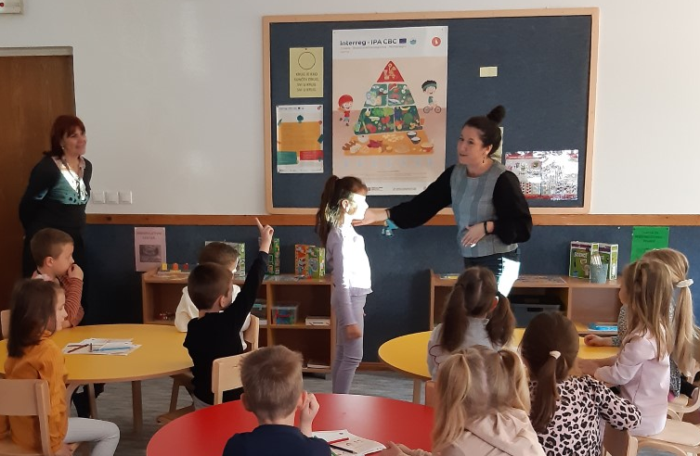
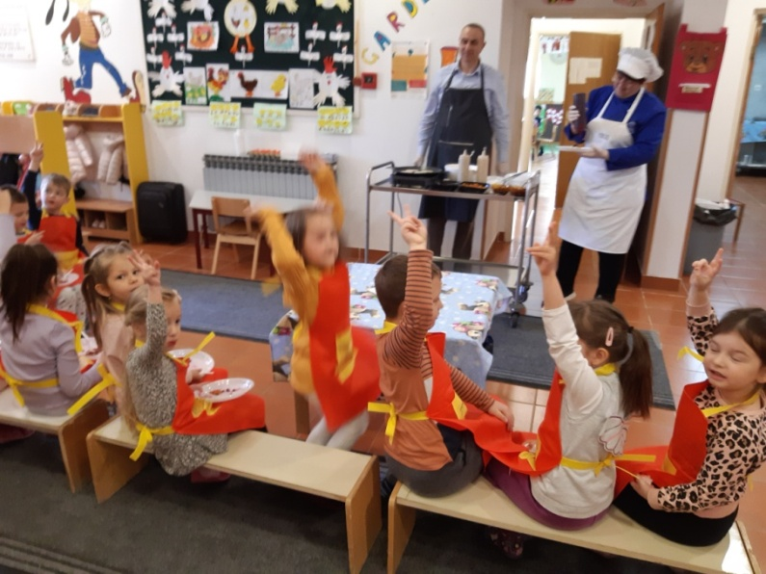
So far activites
Promotion of WG in pre-school and school environment
IPA Interreg CBC Projkct Healthy Eating of Preschool Children - HEPSC
Promotion of healthy nutrition to children parents preschool parents and cooks

Slide 9
So far activites
Preparation for Spring school
List of stakeholders extended
Wholegrain Warm up event attended
Invitations for Wholegrain Spring School sent

Slide 10
Challanges
Long administrative procedures related to joining project as affilated partner
Short time for the implementation of the project
Involvement of public authorities in upplanned activities
New public health challanges
Limited commercial interest in the population health

Slide 11
Thank you for your attention!

